Slide 1
The Big Picture
Edward Banner and Vince Corvo
DSCI6005

Slide 2

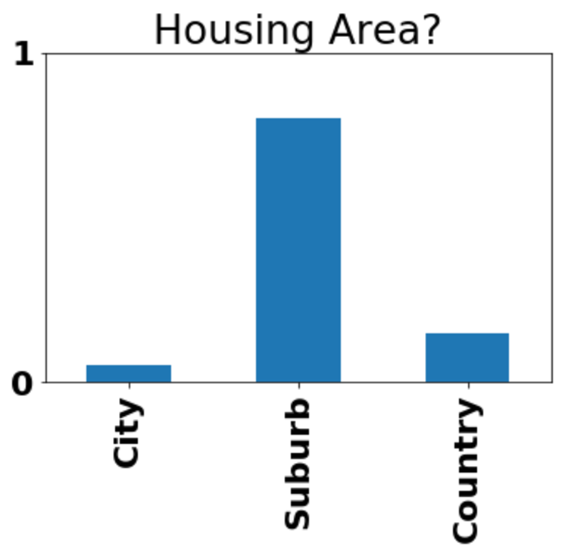
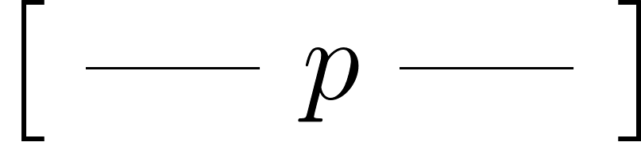
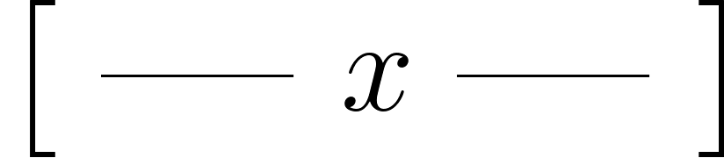
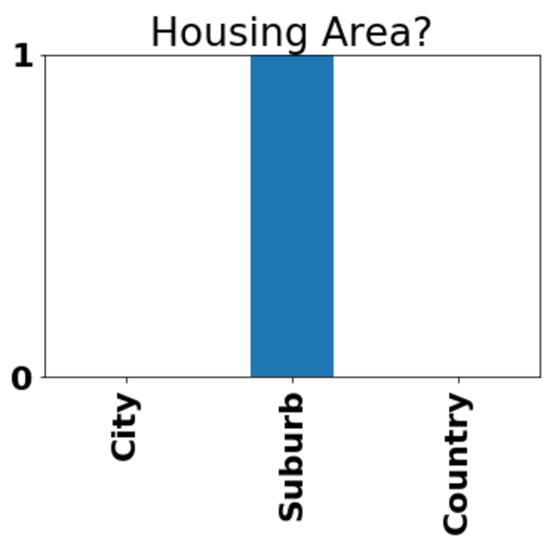
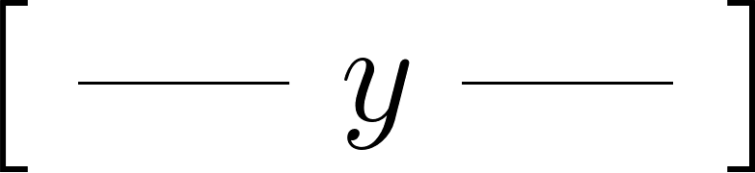





Big Picture

Slide 3


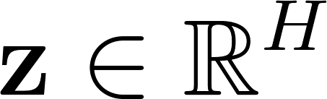




Big Picture

Slide 4
Big Picture

Slide 5
Big Picture

Slide 6
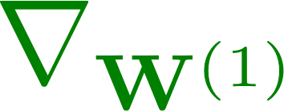
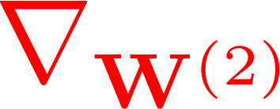
Big Picture

Slide 7
Big Picture

Slide 8
Big Picture

Slide 9

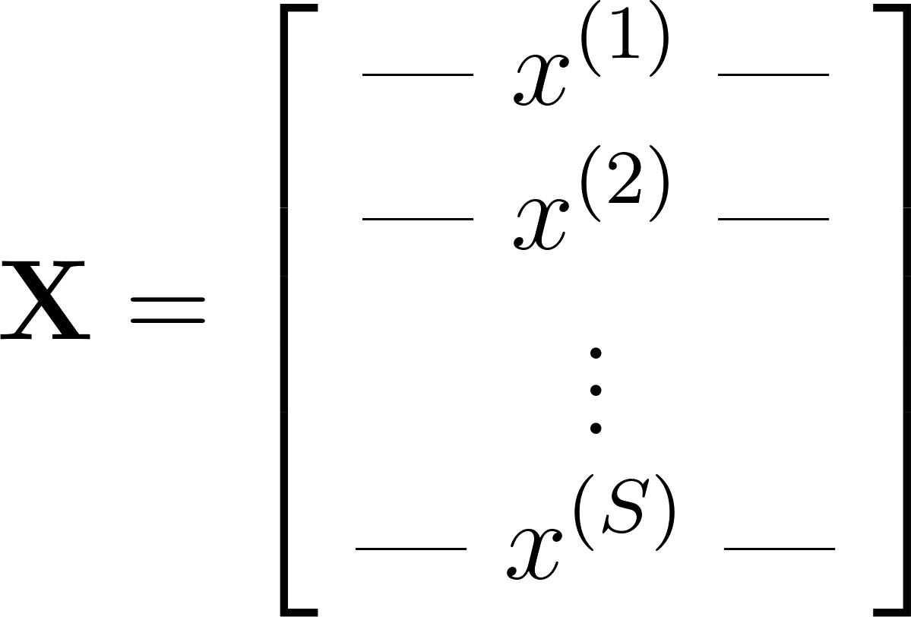
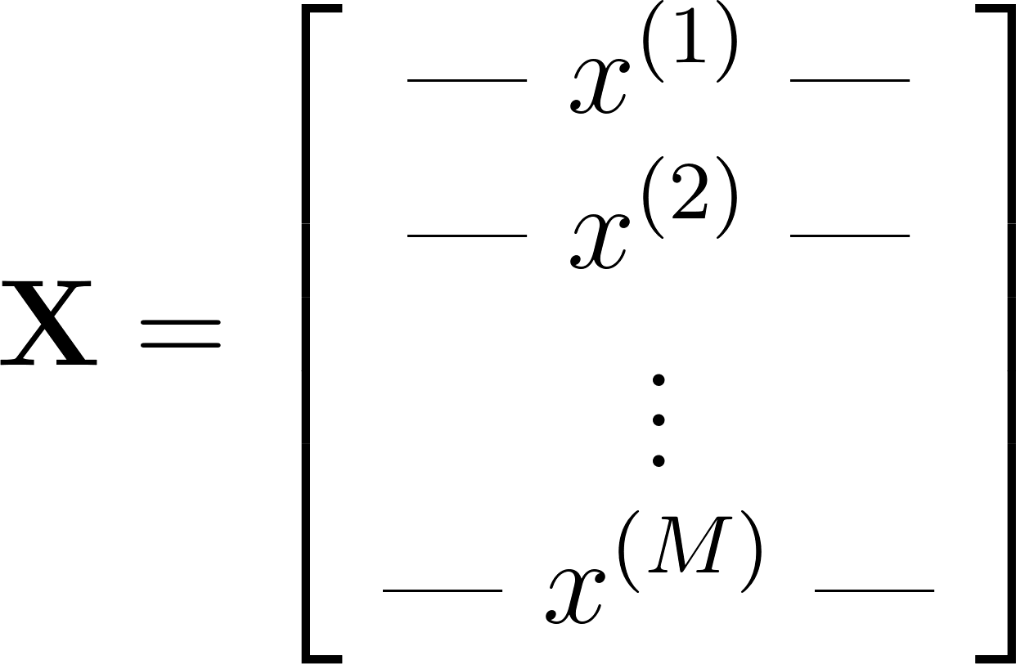


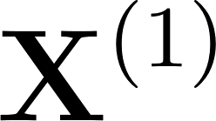
Big Picture

Slide 10



Big Picture

Slide 11


Big Picture

Slide 12


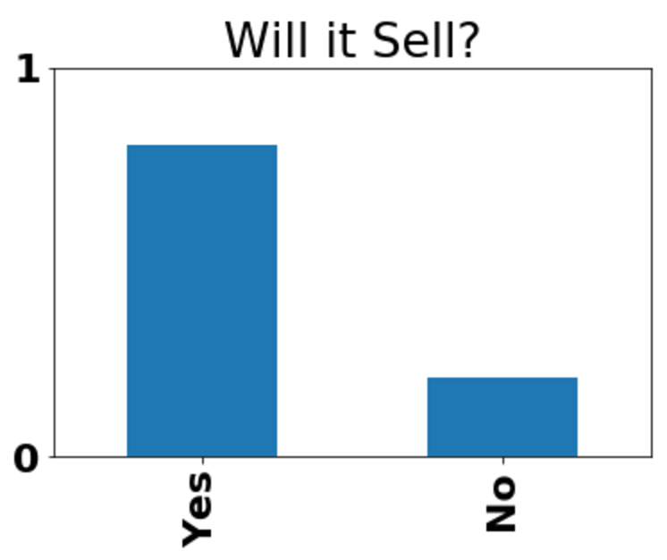

Big Picture

Slide 13



Big Picture

Slide 14




Big Picture

Slide 15










Big Picture

Slide 16
Problem Classes
Input Dimension | 0 | 1 | 2 | 3 | 4 | 5
Layers | Linear | Conv | Pool | Recurrent | Dropout | Batchnorm
Nonlinearities | Sigmoid | Softmax | tanh | ReLU | PReLU | ELU
Output Dimension | 0 | 1 | 2 | 3
Binary Output? | Yes | No
Evaluation | Accuracy | F1 | Precision | Recall | AUC
Evaluation Metric | Categorical Cross Entropy | Log Loss | Hinge Loss | Squared Loss

